Slide 1
HYBRID ENERGY EFFICIENT PROTOCOL USING STABLE CONCENTRIC CLUSTERING
BY,
Thippesh K S(1MS09CS111)
Avinash S(1MS09CS126)
Nishanth T(1MS09CS131)
UNDER THE GUIDANCE OF :
MONICA R MUNDADA
Assoc. Professor.

Slide 2
Introduction:
Wireless sensor network:
Ad-hoc network with sensor nodes.
Two types
Homogeneous wsn.
Heterogeneous wsn.

Slide 3
Heterogeneous Networks
Heterogeneous nodes with different roles & capabilities
If cluster heads may have more energy & computational capability, they take care of transmissions to the base station (BS)
Each node is equipped with different energy levels.

Slide 4
Performance Parameters
Energy efficiency:
Maximum time taken till the death of the last node in the network.
Stability:
Time taken till the death of the first node

Slide 5
OUR GOAL(OBJECTIVE)
To create an hybrid by taking into consideration both energy efficiency and stability.
Using Concentric clustering, SEP and K theorem algorithm.

Slide 6
Stable Election Protocol
Focus on increasing the stable region of network.
Its dynamic.
Uses two level Hierarchical network
Normal nodes
Advanced nodes

Slide 7
Concentric clustering Protocol
Cluster based and Chain based scheme.
Chain based routing scheme(Multihop routing)
Minimum transmission energy (MTE)
Two levels of chain.
Unbalance in energy dissipation.

Slide 8
UI – input the number of
nodes
SYSTEM DESIGN
Generate random positions and energy for each node and display
Advanced node selection module
Creation of concentric cluster module
Cluster Head selection module
Time slot assignment using DRAND
Communication to base station and data tracing module
Simulation result analysis

Slide 9
HEEPSCC
Whole protocol is divided into three phases.
Phase 1: Creation of concentric cluster.
Phase 2: Selection of cluster head.
Phase 3: Data transmission.

Slide 10
1.Creation of Concentric cluster
Base station sends hello packets to all nodes.
First advanced node acknowledges back by sending hello packets.
Thus first concentric cluster is formed.
Further this is followed to form other clusters.

Slide 11
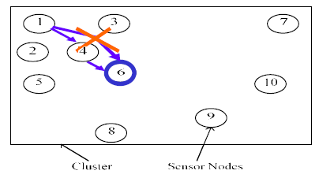
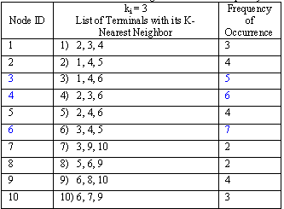
2.Selection of Cluster Head
K Theorem

Slide 12
Combined rating is calculated is using the following equation.
C.R = RE/(D)²
RE=Residual energy.
D=Distance between nodes.

Slide 13
Phase 3: Data transmission
K theorem algorithm chooses cluster head based on distance and residual energy.
All the non cluster head nodes report or send data to the cluster head, which in turn transmit to the advanced nodes.
The advanced node will transmit to the base station.

Slide 14
WORKING PLATFORM
MATLAB.

Slide 15
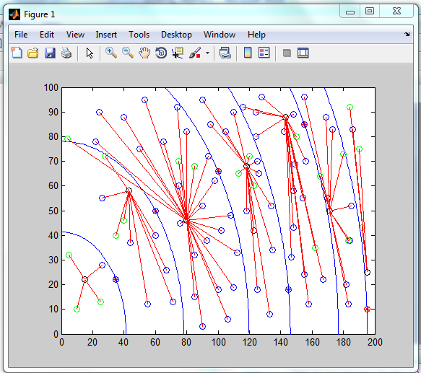
Simulation and results:

Slide 16
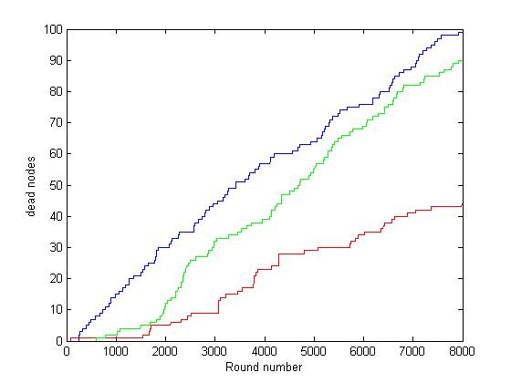
Comparison: HEEPSCC,SEP,CCS
------- SEP
------- HEEPSCC
------- CCS
At the end of 8000 rounds the number of dead nodes in SEP,HEEPSCC,CCS are 99,91,42 respectively.
HEEPSCC is 53.8% more efficient than SEP and 57.5% more efficient than CCS.

Slide 17
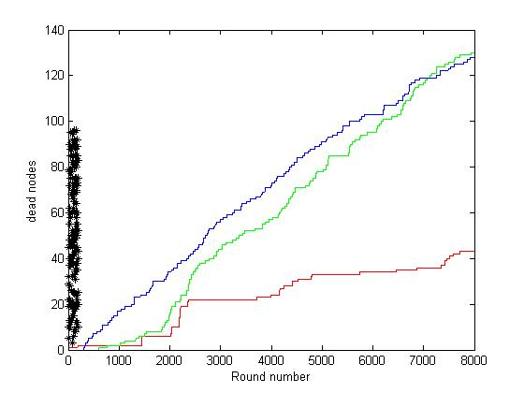
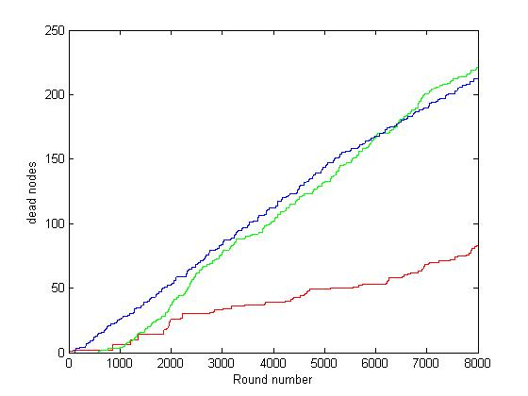
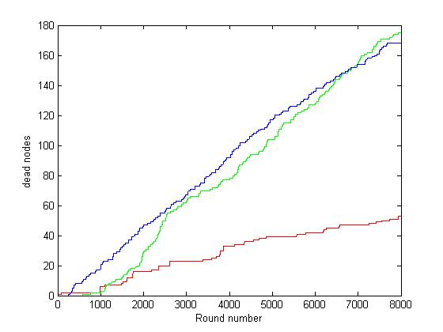
Protocol comparison for 150 nodes.
Protocol comparison for 250 nodes.
Protocol comparison for 200 nodes.

Slide 18
Advantage:
Hybrid protocol (sep and concentric clustering)
Hierarchy of nodes(advanced, CH, sensors)
Energy efficient and stable.
Node heterogeneity (more practical)
Disadvantage:
BS situated only at the edge of the geometrical area.
One CH per concentric cluster.
CH sends aggregated data to respective adv node which is away from BS

Slide 19
Results and Analysis
Ideal number of advanced nodes in the network should be ideally greater than n/20.
Less than n/20 advanced nodes, depreciates the energy efficiency greatly.
Number of nodes in any cluster should be approximately equal to n/nadv . Hence even distribution of nodes is crucial.

Slide 20
Future Scope
Equation of Combined rating can be changed based on requirement and application.
A heterogeneous network with different types of sensors with different energy levels can be implemented.
Alternate rotation of cluster head can be implemented to cover the sparse region in the network.

Slide 21
CONCLUSION
Heterogeneous networks are evaluated in terms of either stability or energy efficiency. HEEPSCC is an hybrid model that bridges the gap between stability and energy efficiency in heterogeneous networks. HEEPSCC is the most stable and energy efficient as it includes both concentric clustering and K theorem technique for creation of cluster and cluster head election.

Slide 22
References
"SEP: A Stable Election Protocol for clustered heterogeneous wireless sensor networks" Georgios Smaragdakis, Ibrahim Matta and Azer Bestavros. Second International Workshop on Sensor and Actor Network Protocols and Applications (SANPA 2004).
X. Li, D. Huang and Z. Sun, "A Routing Protocol for Balancing Energy Consumption in
Heterogeneous Wireless Sensor Networks", MSN 2007, LNCS 4864, 2007, 79.88.

Slide 23
] S. Varma, N. Nigam and U.S. Tiwary, "Base station initiated dynamic routing protocol for heterogeneous Wireless Sensor Network using clustering", Wireless Communications
Y.T. Hou, Y. Shi and H.D. Sherali, .On energy provisioning and relay node placement for wireless
sensor networks,. IEEE Transactions on Wireless Communications 4 (5), 2005, 2579.2590.

